Slide 1
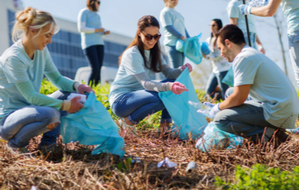
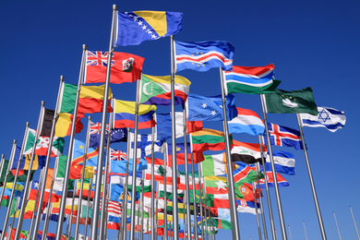
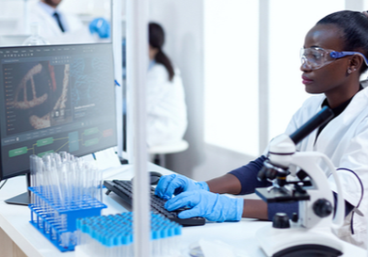
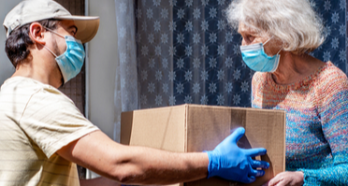
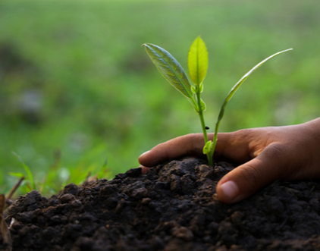
Yes We Can
Notes:
Speaker’s Notes
Throughout this unit, we have learned about many uphill battles facing the Southern Residents. From noise to water pollution and starvation, these struggles can be overwhelming and hard to process. When we learn about such big problems, we can get overwhelmed and feel helpless. In turn, this makes us shutdown and ignore the news.
I want to provide you with tools to make a real and lasting difference. Not just for the Southern Residents, but for any socio-political issues that you might face throughout your lives. Throughout this presentation, we will look at examples of local, national, and global collaborations that have slowed or solved big challenges.
From banning CFCs in the 1980s to stop the ozone hole; to funding, designing, and launching the International Space Station (ISS); to unlocking the roots of disease through the Human Genome Project, individuals, communities, industries, and governments have rallied together to overcoming seemingly insurmountable challenges. When we put our brains and enthusiasm together, we can solve almost any problem!
Photo Credits
Shutterstock
About
This slidedeck is part of Lesson 1 of the Saving the Southern Resident Killer Whales project-based learning unit for middle schoolers. The unit can be downloaded for free from NOAA Fisheries’ website. For questions or comments about this unit, please email wcr.education@noaa.gov.

Slide 2
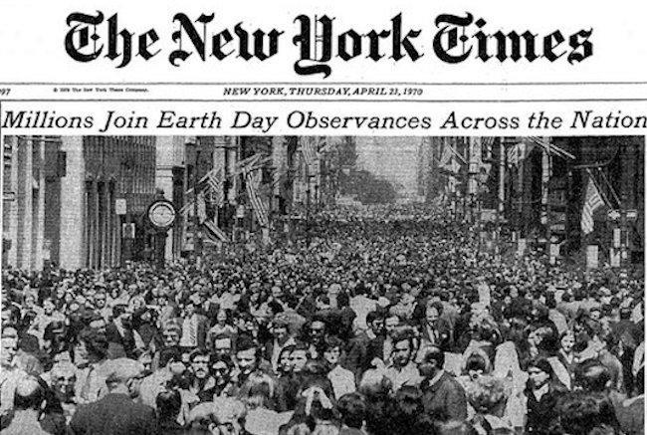
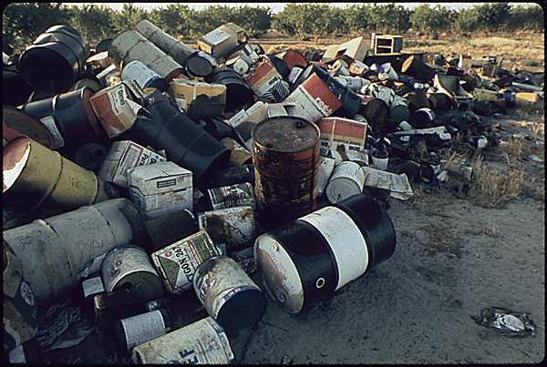
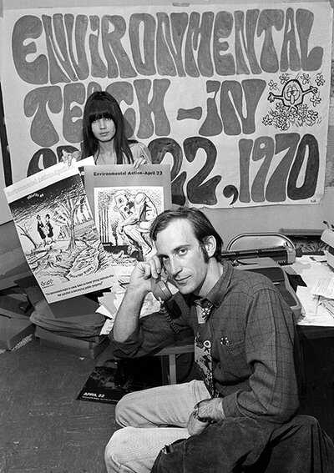
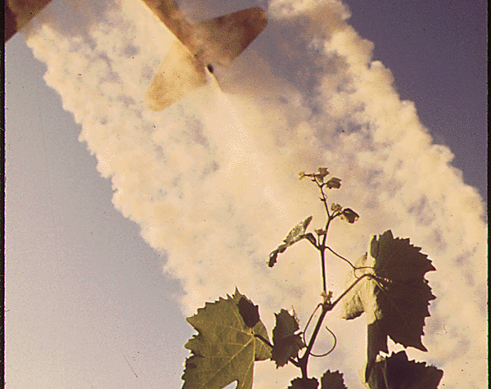
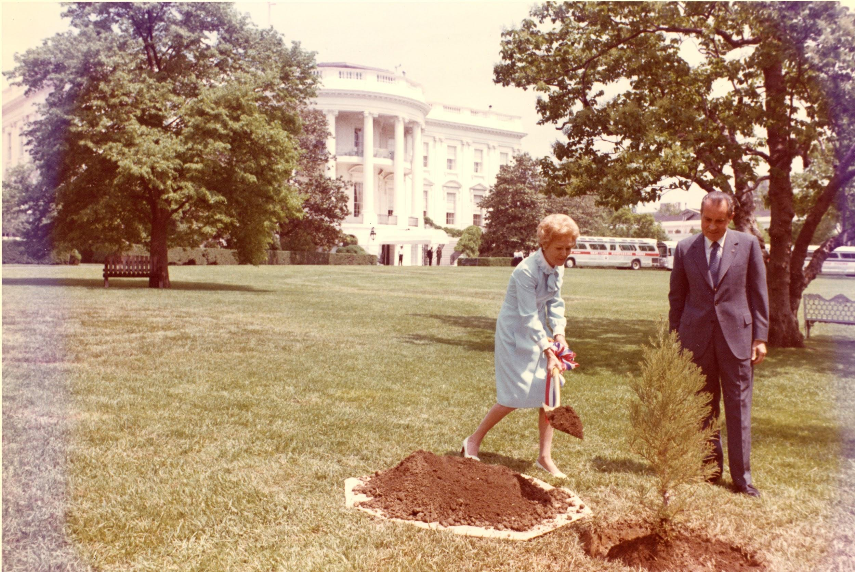
Earth Day - April 22, 1970
Senator Nelson (D-WI), Congressman McCloskey (R-CA), and activist Denis Hayes organized the first Earth Day in response to public outcry.
20 million people participated across the country—the largest demonstration in US history—to protest environmental pollution.
Notes:
Speaker’s Notes
On June 22, 1969, the Cuyahoga River on the southern shores of Lake Erie caught on fire as chemicals, oil, and other industrial materials that had oozed into the river somehow ignited. Just a few months before, on January 28, 1969, an oil rig leaked millions of gallons of oil off the coast of Santa Barbara. That same year, reports surfaced that our national symbol, the bald eagle, was rapidly declining as a species due to the chemical DDT, while around the world, whales were being hunted nearly to extinction. These and other incidents caught the attention of the national media and galvanized public awareness of the many environmental insults being hurled at the nation and the planet. In response to the public outcry, Senator Nelson, organized a nationwide "teach-in" about environmental issues on April 22, 1970. More than 2,000 colleges and universities, 10,000 public schools, and 20 million citizens participated—nearly 10% of the U.S. population at that time. This outpouring of grassroots environmental activism marked the first Earth Day—a recognition of the importance of caring for the environment and accepting stewardship responsibility for the nation's resources. It also helped establish a political climate conducive to forming both the National Oceanic and Atmospheric Administration (NOAA) and the U.S. Environmental Protection Agency (EPA) on October 3, 1970.
Additional Resources
The First Earth Day. The History Channel.
The History of Earth Day. EarthDay.org
Where Citizen Action Works. Frontline
The Modern Environmental Movement. PBS.
Environmental Studies: Documerica by Topic. National Archives
Image Credits
Celebrate Earth Day at home. Fermi National Accelerator Laboratory
Discarded Pesticide Cans. Environmental Protection Agency. 12/2/1970. National Archives Identifier: 542494
Denis Hayes in the Earth Day office, Courtesy: AP Images
Sulfur dusting of Grape Vines. Environmental Protection Agency. 12/2/1970. National Archives Identifier: 542505
President and Mrs. Richard Nixon plant a tree on the White House South Lawn to recognize the first Earth Day. WHPO C6311-11a

Slide 3
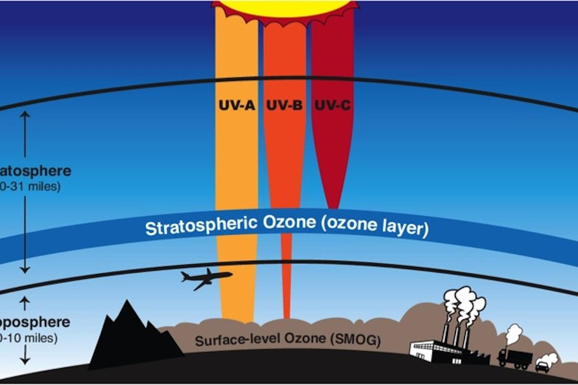
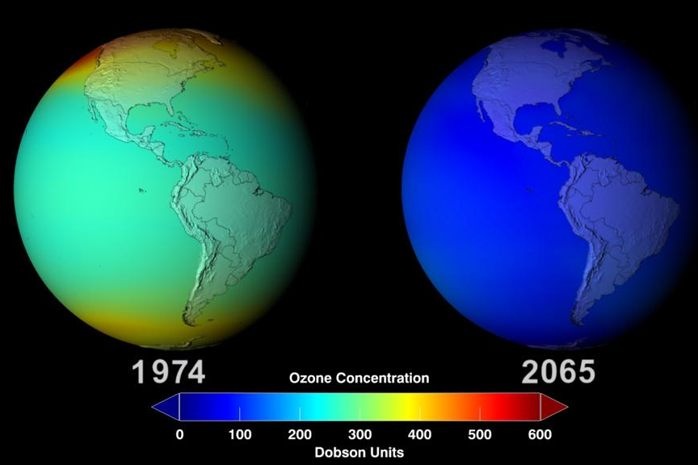
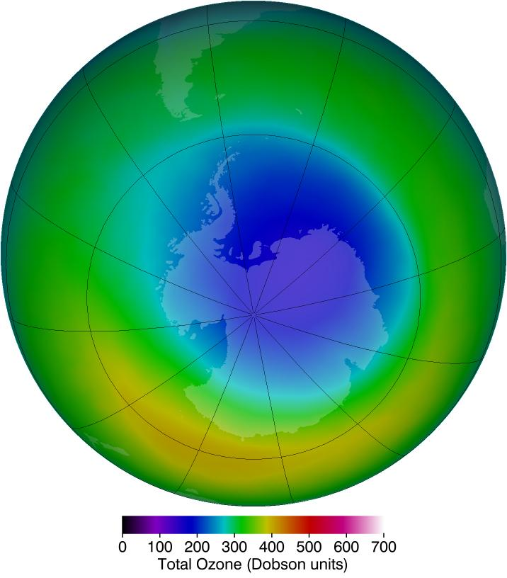
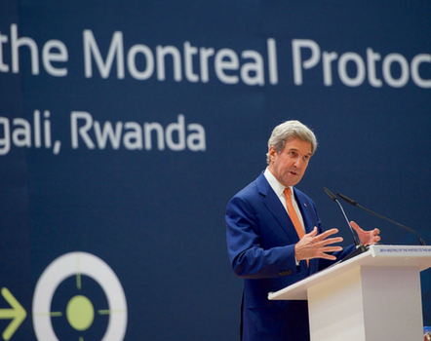
Montreal Protocol on Substances That Deplete the Ozone Layer
In the early 1980s, hundreds of scientists from around the world worked to identify, understand and communicate the seriousness of the threat to the ozone.
Led to an international agreement to eliminate production of ozone-harming substances.
Notes:
Speaker’s Notes
Overexposure to ultraviolet (UV) radiation is a threat to human health. It can cause skin damage, eye damage, and even suppress the immune system. UV overexposure also interferes with environmental cycles, affecting organisms—such as plants and phytoplankton—that move nutrients and energy through the biosphere. In the 1970s, scientists discovered that Earth’s primary protection from UV radiation, the stratospheric ozone layer, was thinning as a result of the use of chemicals that contained chlorine and bromine, which when broken down could destroy ozone molecules. The most common of these ozone-depleting substances (ODS) was a class of chemicals called chlorofluorocarbons (CFCs), which were widely used in a variety of industrial and household applications, such as aerosol sprays, plastic foams, and the refrigerant in refrigerators, air conditioning units in cars and buildings, and elsewhere. Scientific observations of the rapid thinning of the ozone layer over Antarctica from the late 1970s onward—often referred to as the “ozone hole”—catalyzed international action to discontinue the use of CFCs. In 1987, the United States joined 23 other countries and the European Union to sign the Montreal Protocol on Substances that Deplete the Ozone Layer (Montreal Protocol). This international treaty protects and restores the ozone layer by phasing out the production and consumption of certain ozone-depleting substances (ODS).
The Protocol has been joined by all 197 countries of the United Nations (UN), and its parent treaty, the Vienna Convention for the Protection of the Ozone Layer, are the only international treaties to ever achieve this distinction.
Reference
Stratospheric Ozone Protection. United States Environmental Protection Agency. EPA-430-F-17-006. November 2017. www.epa.gov/sites/production/files/2017-12/documents/mp30_report_final_508v3.pdf
Image Credits
NASA and the United Nations

Slide 4
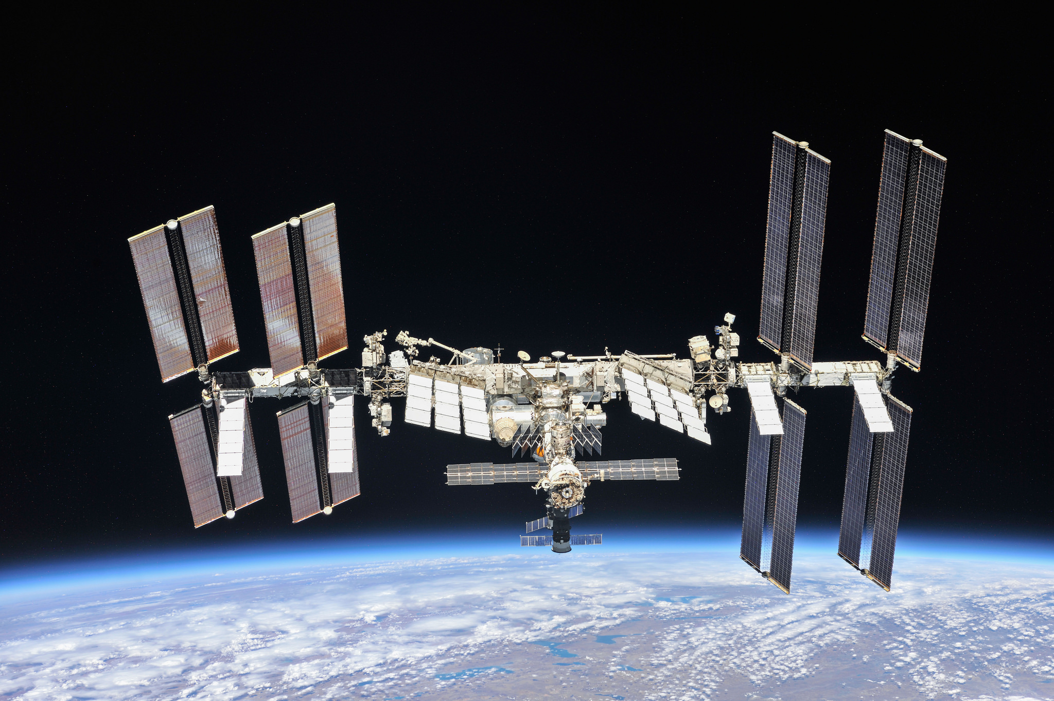
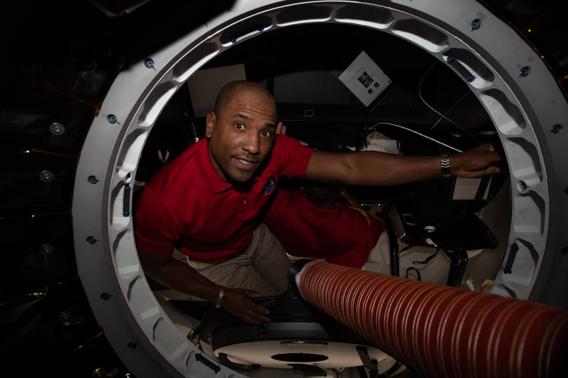
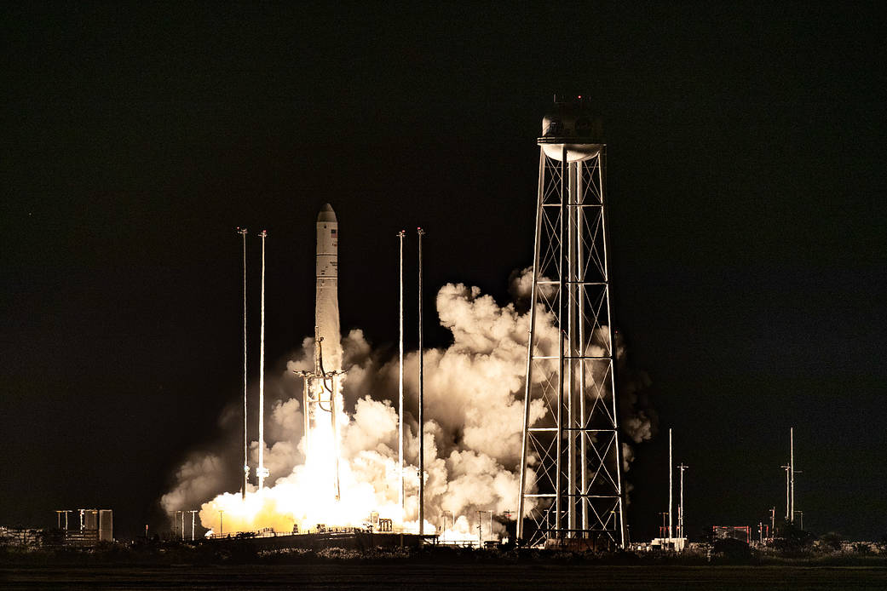
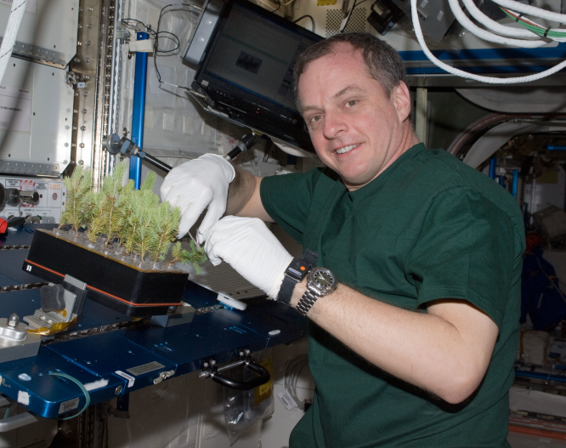
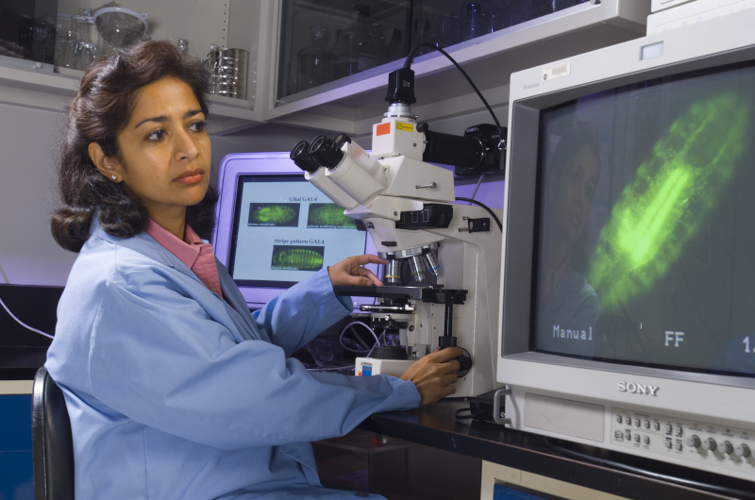
International Space Station (ISS)
Launched in 1998 by the U.S., Russia, Canada, Japan, and the participating countries of the European Space Agency
Most politically complex space exploration program ever undertaken.
Visited by astronauts from 18 countries—and counting.
Notes:
Speaker’s Notes
During his Jan. 25, 1984, State of the Union address to Congress, President Ronald W. Reagan directed NASA to develop a “permanently manned space station and to do it within a decade.” His comments reflected his view of US pre-eminence in space and explicitly stated that the US would invite other nations to join in the project.
The first piece of the International Space Station (ISS) launched in November 1998. More pieces were added over the next two years before the station was ready for people. The first crew arrived on November 2, 2000. People have lived on the ISS ever since.
The ISS took 10 years and more than 30 missions to assemble. It is the result of unprecedented scientific and engineering collaboration among five space agencies representing 15 countries. The space station is approximately the size of a football field: a 460-ton, permanently crewed platform orbiting 250 miles above Earth.
References
Space Station 20th: Historical Origins of ISS. National Aeronautics and Space Administration. Updated: Jan. 23, 2020. www.nasa.gov/feature/space-station-20th-historical-origins-of-iss
History and Timeline of the ISS. Center for the Advancement of Science in Space. www.issnationallab.org/about/iss-timeline/
Image Credits
NASA: www.nasa.gov/multimedia/imagegallery/iotd.html

Slide 5
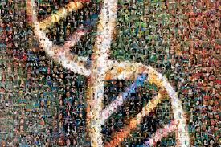
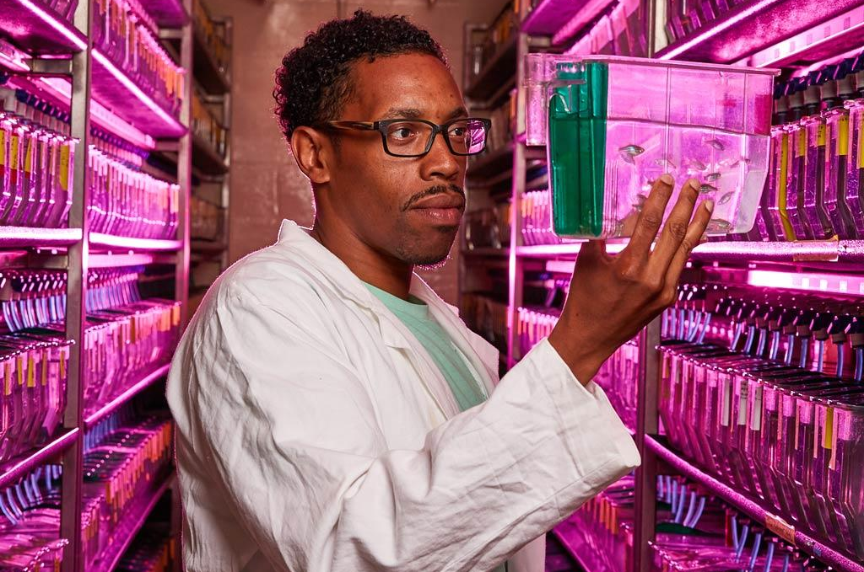
Human Genome Project (HGP)
2,800 researchers from around the world sequenced and mapped all human genes.
Began on October 1, 1990 and completed in April 2003.
Uses information from DNA to develop new ways to treat, cure, or prevent diseases.
Notes:
Speaker’s Notes
Rather than an outward exploration of the planet or the cosmos, the Human Genome Project (HGP) was an inward voyage of discovery. The project was led by an international team of researchers. They sequenced and mapped all genes—together known as the genome—of our species, Homo sapiens.
Beginning on October 1, 1990 and completed in April 2003, the HGP gave us the ability, for the first time, to read nature's complete genetic blueprint for building a human being. More than 2,800 researchers took part in the project.
The HGP has revealed that the human genome contains approximately 3 billion base pairs, which reside in the 23 pairs of chromosomes within the nucleus of all our cells. Each chromosome contains hundreds to thousands of genes, which carry the instructions for making proteins. Each of the estimated 30,000 genes in the human genome makes an average of three proteins.
This research is invaluable. It uses information from DNA to develop new ways to treat, cure, or even prevent the thousands of diseases that afflict humankind.
References
The Human Genome Project. National Human Genome Research Institute. www.genome.gov/human-genome-project.
Image Credits
National Human Genome Research Institute

Slide 6
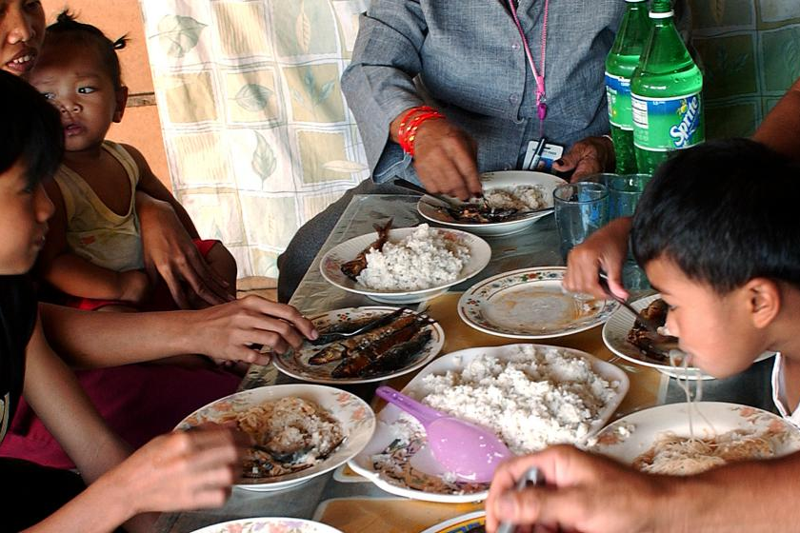
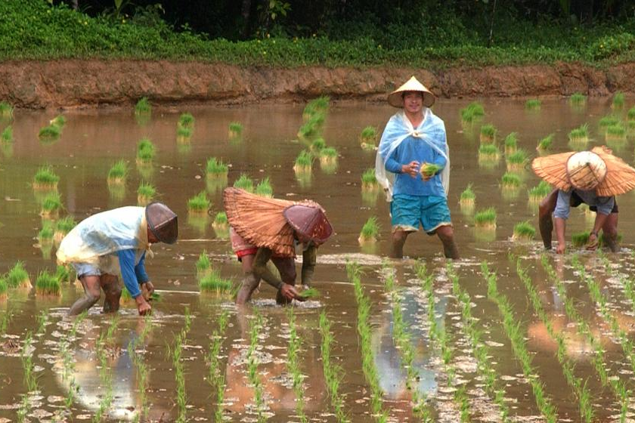
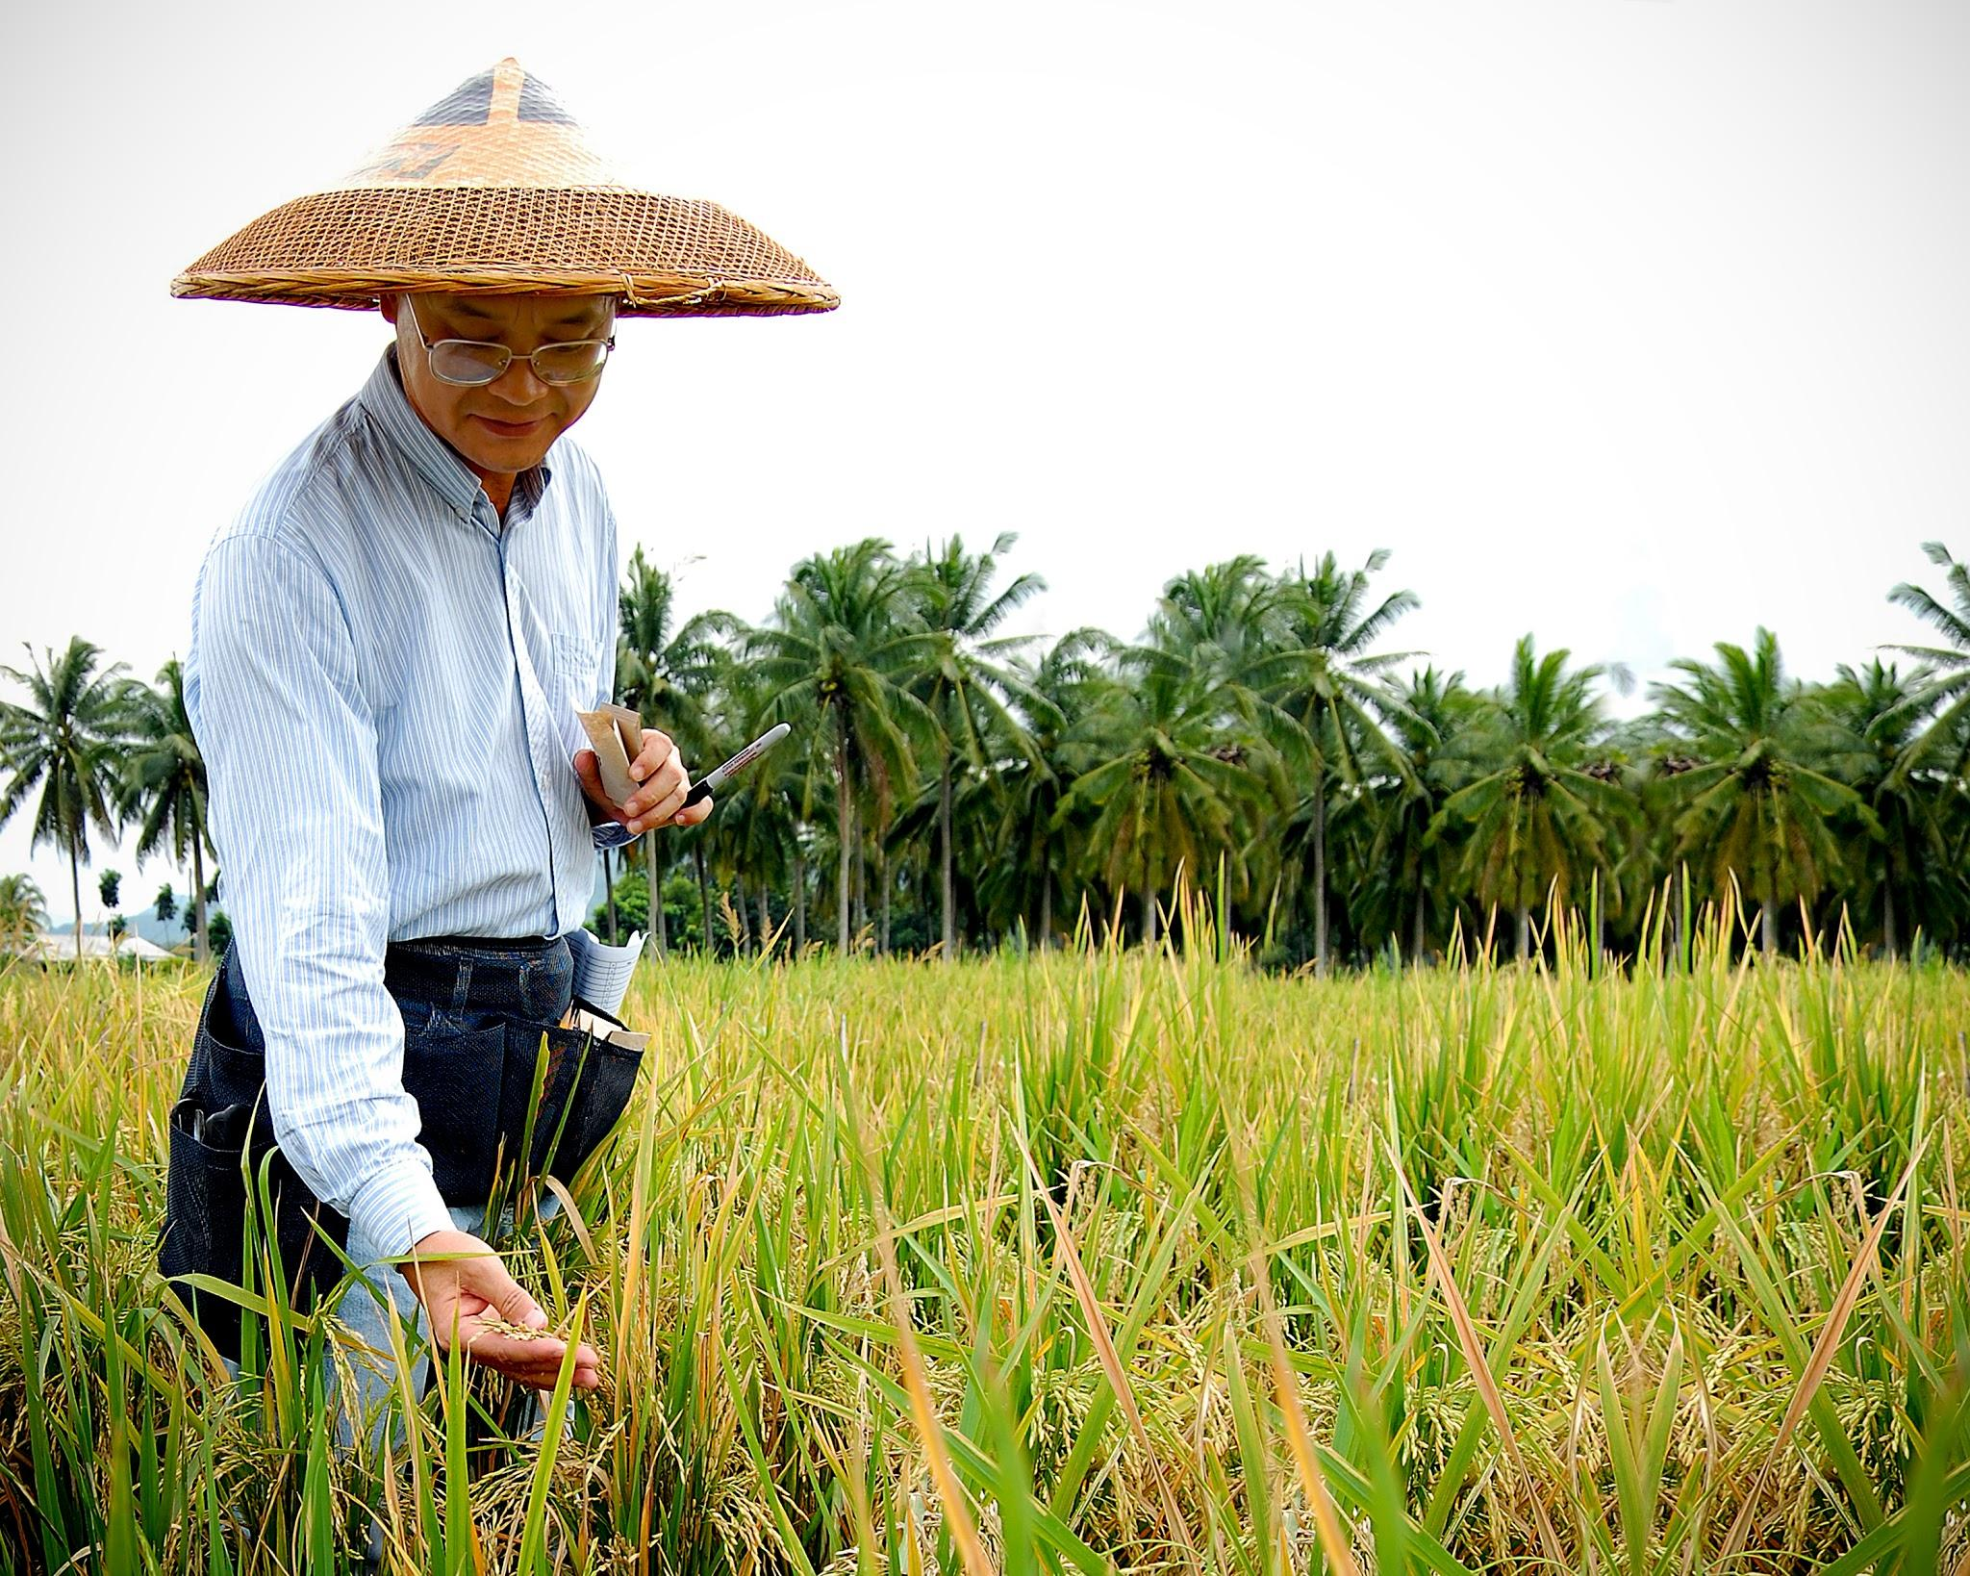
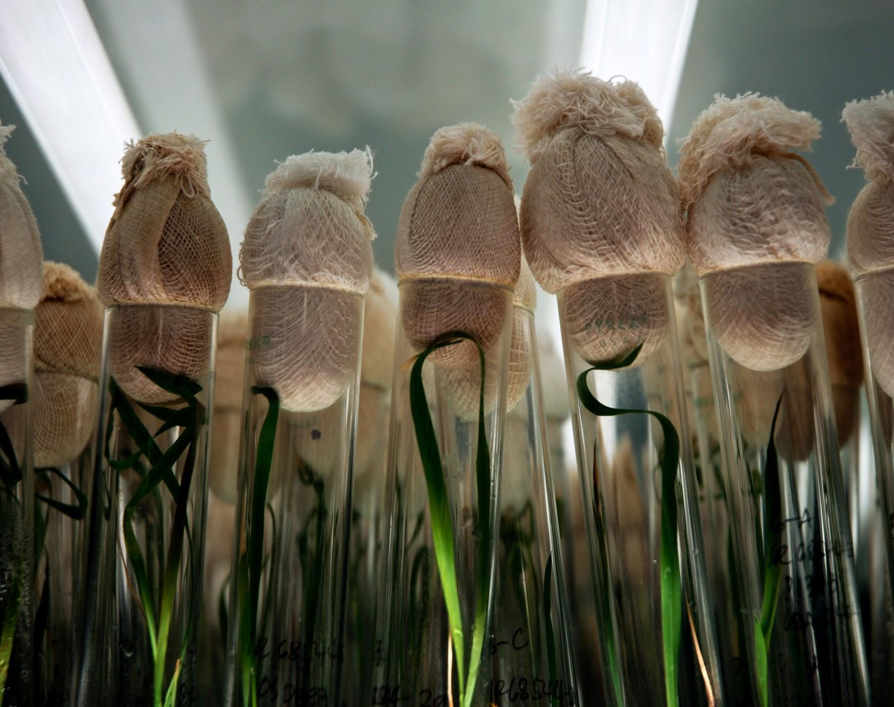
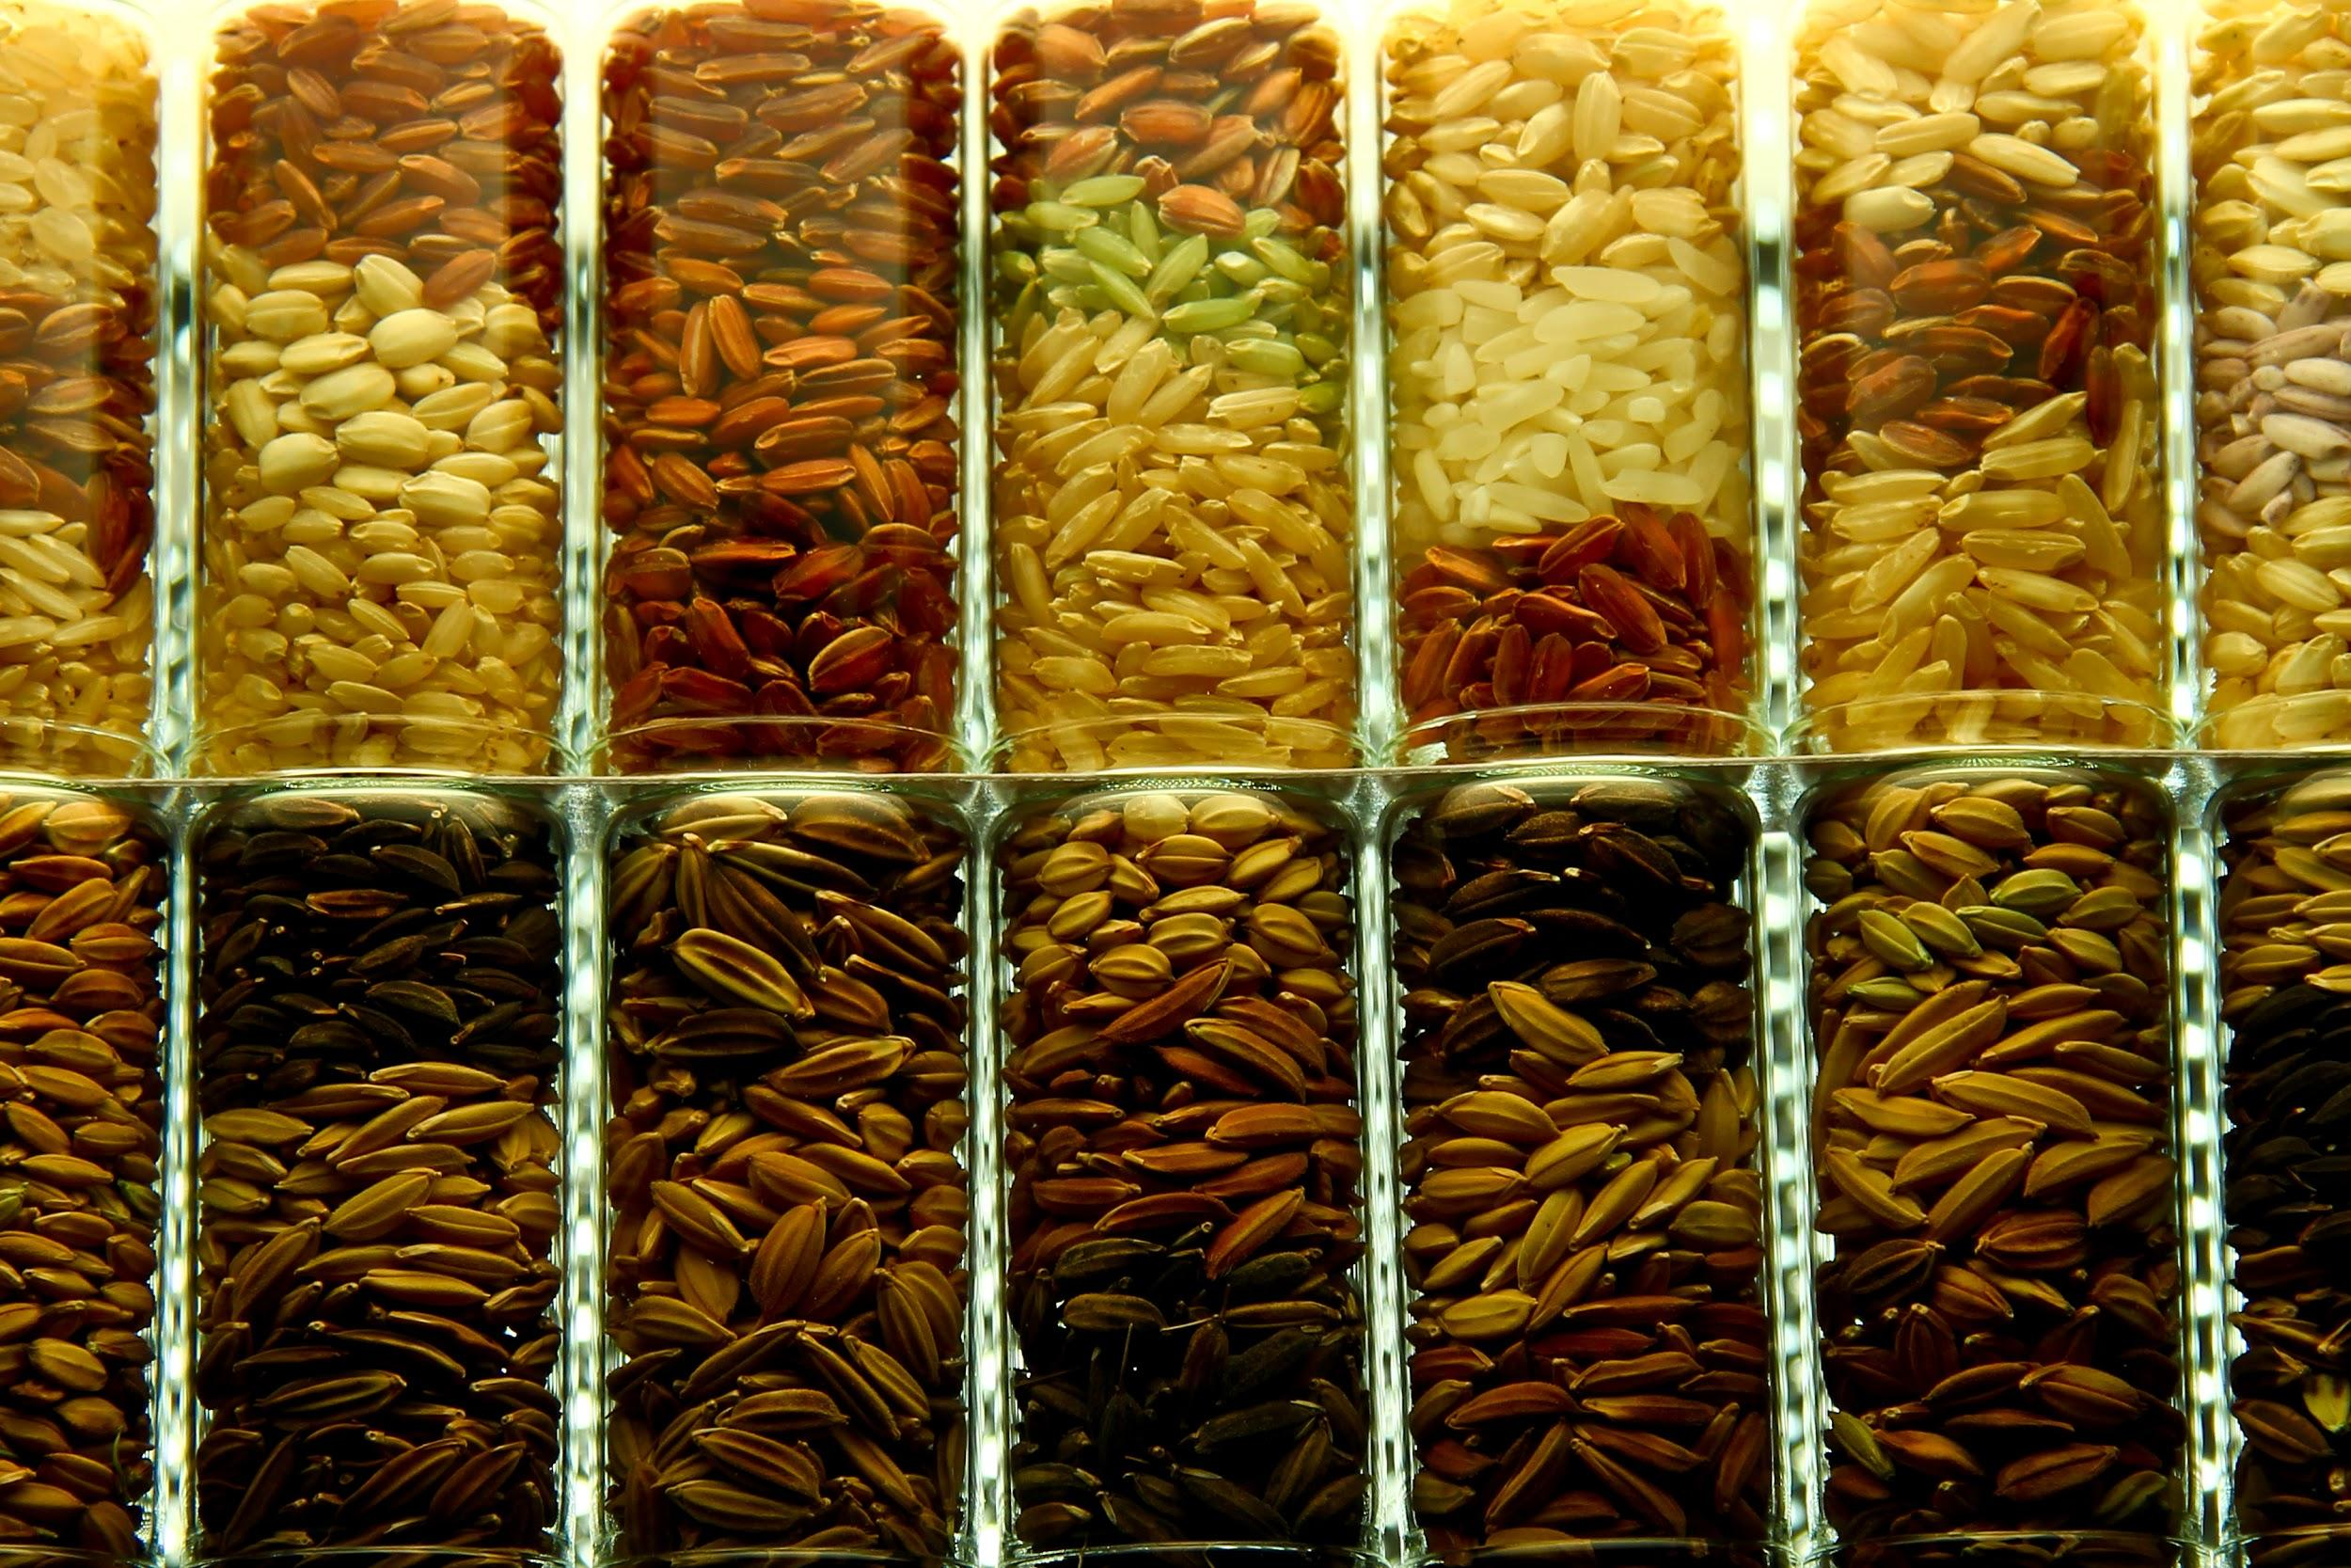
International Rice Research Institute (IRRI)
More than half of the world’s population relies on rice for most or their entire calorie needs.
IRRI develops more nutritious rice to address hunger and malnutrition.
Aims to make rice farming more sustainable by requiring less fertilizer and water.
Notes:
Speaker’s Notes
More than half of the world’s population, including many of those living in poverty, rely on rice for most of their daily calories because they cannot afford—or do not have access to—nutritious foods such as fruits, vegetables, meat, and dairy. As a result, malnutrition is a real threat.
The International Rice Research Institute (IRRI) develops rice enriched with vitamins and nutrients. The IRRI also identifies rice varieties with lower glycemic index and antioxidant properties.
The IRRI produced one of the first of the modern, high-yielding, varieties of rice that helped stave off the mass famine that was predicted for Asia in the1970s.
The IRRI is currently seeking approval for its Golden Rice, which addresses vitamin A deficiency. Vitamin A deficiency is a serious public health problem affecting millions of children and pregnant women globally. It is the leading cause of preventable blindness in children, and increases the risk of disease and death from severe infections.
IRRI’s international team works closely with research networks, governments, development sector, private sector, and farmer communities.
Reference
Our Work > Nutrition and Food Security. International Rice Research Institute. www.irri.org/our-work/impact-challenges/nutrition-food-security.
Image Credits
Raymond Panaligan/IRRI/www.irri.org/safe-and-healthy-rice
Aileen Del Rosario/IRRI/https://www.irri.org/where-we-work/countries/southeast-asia
Bill Sta. Clara/IRRI/https://hrdc.irri.org/about-us/
Ariel Javellana/CPS/https://hrdc.irri.org/about-us/
Isagani Serrano/CPS/https://hrdc.irri.org/germplasm-exchange/

Slide 7
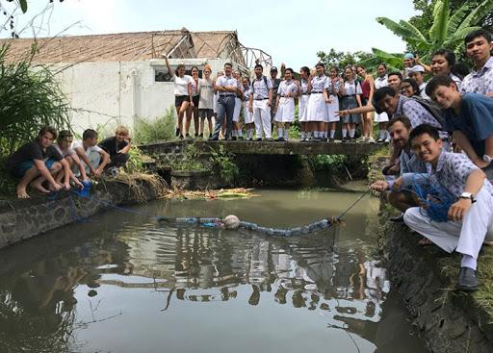
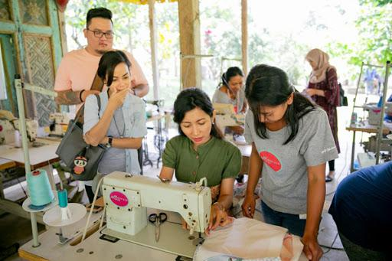
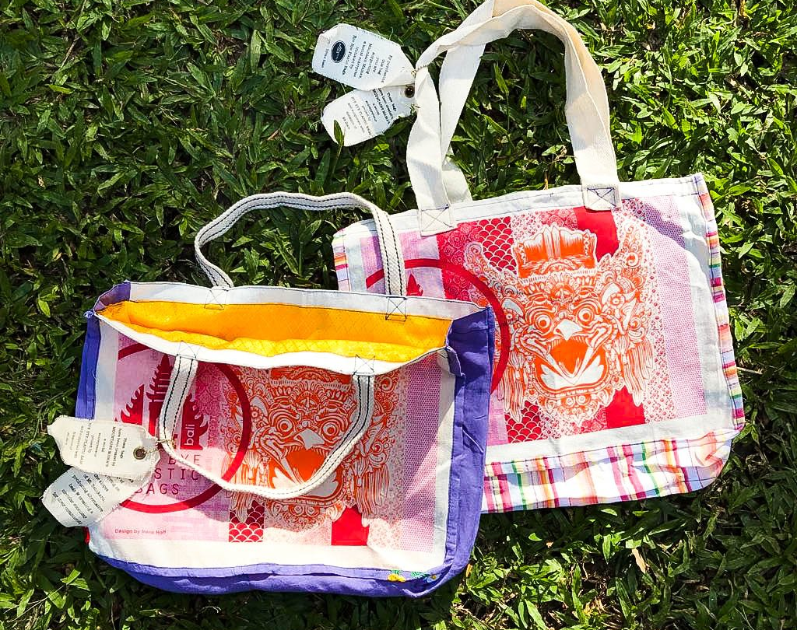
Bye Bye Plastic Bags
Two young sisters help ban plastic bags in Bali, Indonesia.
Their organization now has 25 chapters around the world.
They are teaching others how to advocate for future free of plastic bags.
Notes:
Speaker’s Notes
Sisters Isabel and Melati Wijsen are co-founders of Bye Bye Plastic Bags. This youth-led organization envisions a world free of plastic bags and where the young generation are empowered to take action.
When they were just 10 and 12 years old, the sisters became inspired by the work of Nelson Mandela, Martin Luther King Jr., and Mahatma Gandhi and setout to make a difference. They decided to focus on the plastic pollution affecting Bali. Bali is part of the island nation of Indonesia, which is the world's second biggest polluter of marine plastic. Their advocacy and petition played a part in the Bali government's decision to ban plastic bags.
Bye Bye Plastic Bags now has 25 locations around the world. The organization raises awareness of plastic’s impact on the environment and trains women to make reusable bags from donated or recycled materials.
References
Herrera, Kio and Mordechai, Rebecca. Kid Heroes for the Planet. Time for Kids. 2019 April 2019. www.timeforkids.com/g56/kid-heroes-planet/
Sullivan, Michael. How Teenage Sisters Pushed Bali To Say 'Bye-Bye' To Plastic Bags. National Public Radio. 2019 January 26. www.npr.org/sections/goatsandsoda/2019/01/26/688168838
Image Credits
Bye Bye Plastic Bags /

Slide 8
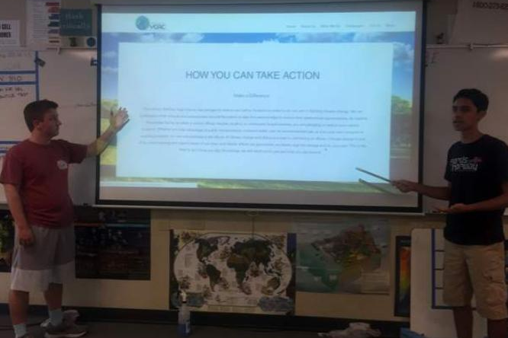
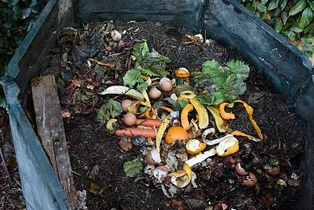
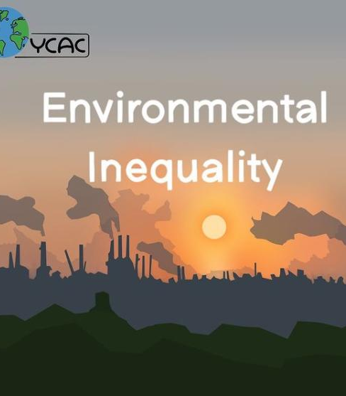
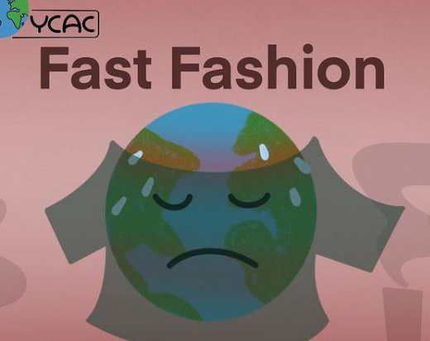
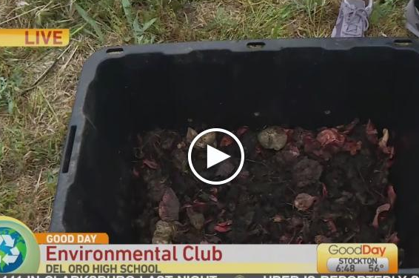
Youth Climate Action Coalition (YCAC)
After greening their own high school, students wanted to make a difference.
They work with schools and organizations around the world to develop customized action plans.
Notes:
Speaker’s Notes
When students at Del Oro High School in Northern California realized their generation would be feeling the pressing effects of climate change, they founded an environmental club to take action. In a few short years, the school collected over 4,000 pounds of food waste and reduced its carbon footprint by nearly two tons. Students also installed faucet aerators and reduced their school’s water usage by thousands of gallons. Not only did these changes help the environment, they also helped the school save money.
After greening their own school, the students wanted to affect even more change. The group has created a Youth Climate Action Coalition pledge. After a student, teacher, or community member signs the pledge, YCAC members help the school or organization develop a customized action plan. So far, more than 10,000 students in 50 schools across 30 countries have signed the pledge. YCAC has leveraged their passion and experience to make a difference around the world.
References
Kevin Malaekeh. Youth Climate Action Coalition. Ashoka Changemakers. 15 May 2020. https://network.changemakers.com/challenge/stemforchangemaking2020/winners-announced/youth-climate-action-coalition/comments.
About Us. Youth Climate Action Coalition. www.ycacyouth.org/about-us.
Image Credits

Slide 9
Together We Can Make a Difference
Notes:
Speaker’s Notes
We know the problems facing Southern Residents, and we know some potential solutions. Now let’s get to work and make a difference!
Photo Credit
Shutterstock

